Slide 1

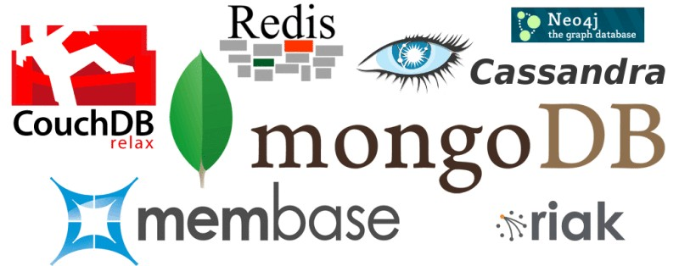
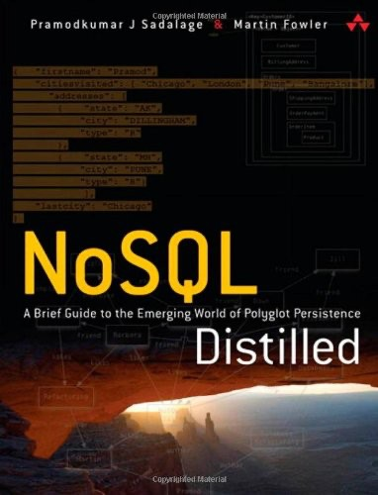
Document Oriented Database

Slide 2
What is Document Oriented Database?
A document database, also known as a document-oriented database, is a type of NoSQL database that stores data in the form of documents, rather than in tables with rows and columns like a traditional relational database. These documents can be in a variety of formats, such as JSON, BSON, or XML. They often include nested data structures, which can make it easier to store and query complex data. Document databases are well suited for storing semi-structured data and are often used in web and mobile applications.

Slide 3
Document Data Model
{
"_id": "12345",
"name": "John Smith",
"email": "john.smith@example.com",
"address": {
"street": "123 Main St",
"city": "Anytown",
"state": "NY",
"zip": "12345"
},
"preferences": {
"language": "en",
"notifications": true
},
"orders": [
{ "order_id": "54321", "total": 100 },
{ "order_id": "67890", "total": 50 }
]
}
In a document database, data is stored in the form of documents, which can include nested data structures. Each document can have a unique structure and can contain different fields. This is in contrast to a relational database, where data is stored in tables with a fixed schema.
An example of a document data model could be a collection of “users” where each document represents a single user and contains fields such as name, email, address, and preferences. An example of a document for a user could be:
In this example, the user document contains fields for the user’s name, email, and address, as well as nested fields for the address (street, city, state, zip) and preferences (language, notifications). Additionally, the user has an array of orders which is another nested data structure.
Note that the structure of the documents can vary from one document to another, this is one of the key features of document databases, it allows to have a more flexible and dynamic schema for the data.

Slide 4
Document Database Design
Data modeling: This involves deciding how to organize and structure the data in your database. In document databases, data is stored in the form of documents, which can include nested data structures. The structure of the documents should be designed to support the queries and use cases of your application.
Indexing: Indexing allows for fast searching and querying of the data. In document databases, you can index specific fields in the documents to improve query performance. It’s important to carefully consider which fields to index, as too many indexes can lead to decreased performance.
Sharding: Sharding is the process of distributing the data across multiple servers to improve performance and scalability. In a document database, sharding can be done based on the value of a specific field in the documents, such as the user ID.

Slide 5
Document Database Design
Replication: Replication involves creating multiple copies of the data to improve reliability and availability. In document databases, replication can be done in a variety of ways, such as master-slave replication or peer-to-peer replication.
Data validation: Data validation involves specifying rules for how data is stored in the database. Some document databases support data validation, which can help ensure data consistency and integrity.
Security: Document databases should have a robust security mechanism to protect against unauthorized access to the data. It’s important to consider how to secure data at rest and in transit, as well as how to authenticate and authorize users.
Backup and Recovery: Document databases should have a robust backup and recovery plan in place to ensure that data is not lost in case of a disaster.

Slide 6
What Core Operations Document Database Support
Document databases typically support a variety of core operations, including:
CRUD (Create, Read, Update, and Delete) operations: These are the basic operations for creating, reading, updating, and deleting documents in the database.
Indexing: Document databases often support indexing of documents, which allows for fast searching and querying of the data.
Aggregation: The ability to group and summarize data based on certain criteria, similar to SQL’s GROUP BY and aggregate functions.
Sharding: Distributes the data across multiple servers to improve performance and scalability.
Replication: Allows for multiple copies of the data to be stored on different servers for improved reliability and availability.
Data validation: Some document databases support data validation, which allows you to specify rules for how data is stored in the database.
Transactions: Document databases usually support atomic transaction operations for multiple documents, ensuring data consistency.

Slide 7
Use Cases of Document Database
Document databases are well suited for a variety of use cases, including:
Content management systems: Document databases can be used to store and manage large amounts of content, such as articles, blog posts, and images.
E-commerce and retail: Document databases can be used to store product information, customer data, and order history.
Social media: Document databases can be used to store user profiles, comments, and other data associated with social media platforms.
Gaming: Document databases can be used to store player data, game progress, and leaderboards.

Slide 8
Use Cases of Document Database
IoT: Document databases can be used to store sensor data and other information generated by Internet of Things (IoT) devices.
Logging and monitoring: Document databases can be used to store and analyze log data for debugging and performance monitoring.
User data: Document databases can be used to store user data, such as preferences and personal information, for web and mobile applications.
Financial services: Document databases can be used to store financial data, such as transactions and account information.

Slide 9
Document Database Suitable Use Cases
Event Logging: Applications have different event logging needs; within the enterprise, there are many different applications that want to log events. Document databases can store all these different types of events and can act as a central data store for event storage. This is especially true when the type of data being captured by the events keeps changing. Events can be sharded by the name of the application where the event originated or by the type of event such as order_processed or customer_logged.
Content Management Systems, Blogging Platforms: Since document databases have no predefined schemas and usually understand JSON documents, they work well in content management systems or applications for publishing websites, managing user comments, user registrations, profiles, web-facing documents.
Web Analytics or Real-Time Analytics: Document databases can store data for real-time analytics; since parts of the document can be updated, it’s very easy to store page views or unique visitors, and new metrics can be easily added without schema changes.
E-Commerce Applications: E-commerce applications often need to have flexible schema for products and orders, as well as the ability to evolve their data models without expensive database refactoring or data migration

Slide 10
Popular Document Databases
There are many popular document databases available, some of the most well-known ones include:
MongoDB: One of the most widely used document databases, MongoDB is known for its scalability, performance, and ease of use.
Couchbase: A document database that supports both SQL and NoSQL querying. It also provides a built-in caching layer for improved performance.
RavenDB: A document database that focuses on performance and ease of use, with built-in support for full-text search and indexing.
Amazon DocumentDB: A managed document database service provided by Amazon Web Services, it is compatible with MongoDB and can be used to easily scale and replicate data.

Slide 11
Popular Document Databases
Cloud Firestore: A document-oriented NoSQL database service provided by Google Cloud Platform, it can be used to easily store, sync, and query data for web, mobile, and IoT applications.
CosmosDB: A multi-model, globally distributed database service provided by Microsoft Azure, it supports document, key-value, graph, and column-family data models.
CouchDB: An open-source document-oriented database that uses a document-based data model, it also supports ACID semantics, map-reduce and incremental replication.

Slide 12
Document Database Features
While there are many specialized document databases, we will use MongoDB as a representative of the feature set. Keep in mind that each product has some features that may not be found in other document databases.
Let’s take some time to understand how MongoDB works. Each MongoDB instance has multiple databases, and each database can have multiple collections. When we compare this with RDBMS, an RDBMS instance is the same as MongoDB instance, the schemas in RDBMS are similar to MongoDB databases, and the RDBMS tables are collections in MongoDB. When we store a document, we have to choose which database and collection this document belongs in—for example, database.collection.insert(document), which is usually represented as db.coll.insert(document).
Features are
Consistency
Transactions
Availability
Query Features
Scaling

Slide 13
Document Database Features - Consistency
Consistency in MongoDB database is configured by using the replica sets and choosing to wait for the writes to be replicated to all the slaves or a given number of slaves. Every write can specify the number of servers the write has to be propagated to before it returns as successful. A command like db.runCommand({ getlasterror : 1 , w : "majority" }) tells the database how strong is the consistency you want. For example, if you have one server and specify the w as majority, the write will return immediately since there is only one node. If you have three nodes in the replica set and specify w as majority, the write will have to complete at a minimum of two nodes before it is reported as a success. You can increase the w value for stronger consistency but you will suffer on write performance, since now the writes have to complete at more nodes. Replica sets also allow you to increase the read performance by allowing reading from slaves by setting slaveOk; this parameter can be set on the connection, or database, or collection, or individually for each operation.
Mongo mongo = new Mongo("localhost:27017");
mongo.slaveOk();
Here we are setting slaveOk per operation, so that we can decide which operations can work with data from the slave node.

Slide 14
Document Database Features - Consistency
DBCollection collection = getOrderCollection();
BasicDBObject query = new BasicDBObject();
query.put("name", "Martin");
DBCursor cursor = collection.find(query).slaveOk();
Similar to various options available for read, you can change the settings to achieve strong write consistency, if desired. By default, a write is reported successful once the database receives it; you can change this so as to wait for the writes to be synced to disk or to propagate to two or more slaves. This is known as WriteConcern: You make sure that certain writes are written to the master and some slaves by setting WriteConcern to REPLICAS_SAFE. Shown below is code where we are setting the WriteConcern for all writes to a collection: DBCollection shopping = database.getCollection("shopping"); shopping.setWriteConcern(REPLICAS_SAFE);
WriteConcern can also be set per operation by specifying it on the save command:
WriteResult result = shopping.insert(order, REPLICAS_SAFE);
There is a tradeoff that you need to carefully think about, based on your application needs and business requirements, to decide what settings make sense for slaveOk during read or what safety level you desire during write with WriteConcern.

Slide 15
Document Database Features - Transactions
Transactions, in the traditional RDBMS sense, mean that you can start modifying the database with insert, update, or delete commands over different tables and then decide if you want to keep the changes or not by using commit or rollback.
These constructs are generally not available in NoSQL solutions—a write either succeeds or fails. Transactions at the single-document level are known as atomic transactions.
Transactions involving more than one operation are not possible, although there are products such as RavenDB that do support transactions across multiple operations. By default, all writes are reported as successful. A finer control over the write can be achieved by using WriteConcern parameter.
We ensure that order is written to more than one node before it’s reported successful by using WriteConcern.REPLICAS_SAFE. Different levels of WriteConcern let you choose the safety level during writes; for example, when writing log entries, you can use lowest level of safety, WriteConcern.NONE

Slide 16
Document Database Features - Transactions
final Mongo mongo = new Mongo(mongoURI); mongo.setWriteConcern(REPLICAS_SAFE);
DBCollection shopping = mongo.getDB(orderDatabase) .getCollection(shoppingCollection);
try
{
WriteResult result = shopping.insert(order, REPLICAS_SAFE);
//Writes made it to primary and at least one secondary
}
catch (MongoException writeException)
{
//Writes did not make it to minimum of two nodes including primary dealWithWriteFailure(order, writeException);
}

Slide 17
Document Database Features - Availability
The CAP theorem (“The CAP Theorem,” p. 53) dictates that we can have only two of Consistency, Availability, and Partition Tolerance. Document databases try to improve on availability by replicating data using the master-slave setup. The same data is available on multiple nodes and the clients can get to the data even when the primary node is down. Usually, the application code does not have to determine if the primary node is available or not. MongoDB implements replication, providing high availability using replica sets.
In a replica set, there are two or more nodes participating in an asynchronous master-slave replication. The replica-set nodes elect the master, or primary, among themselves. Assuming all the nodes have equal voting rights, some nodes can be favored for being closer to the other servers, for having more RAM, and so on; users can affect this by assigning a priority—a number between 0 and 1000—to a node.

Slide 18
Document Database Features - Availability
All requests go to the master node, and the data is replicated to the slave nodes. If the master node goes down, the remaining nodes in the replica set vote among themselves to elect a new master; all future requests are routed to the new master, and the slave nodes start getting data from the new master. When the node that failed comes back online, it joins in as a slave and catches up with the rest of the nodes by pulling all the data it needs to get current.
We have two nodes, mongo A and mongo B, running the MongoDB database in the primary data-center, and mongo C in the secondary datacenter. If we want nodes in the primary datacenter to be elected as primary nodes, we can assign them a higher priority than the other nodes. More nodes can be added to the replica sets without having to take them offline.
The application writes or reads from the primary (master) node. When connection is established, the application only needs to connect to one node (primary or not, does not matter) in the replica set, and the rest of the nodes are discovered automatically. When the primary node goes down, the driver talks to the new primary elected by the replica set.

Slide 19
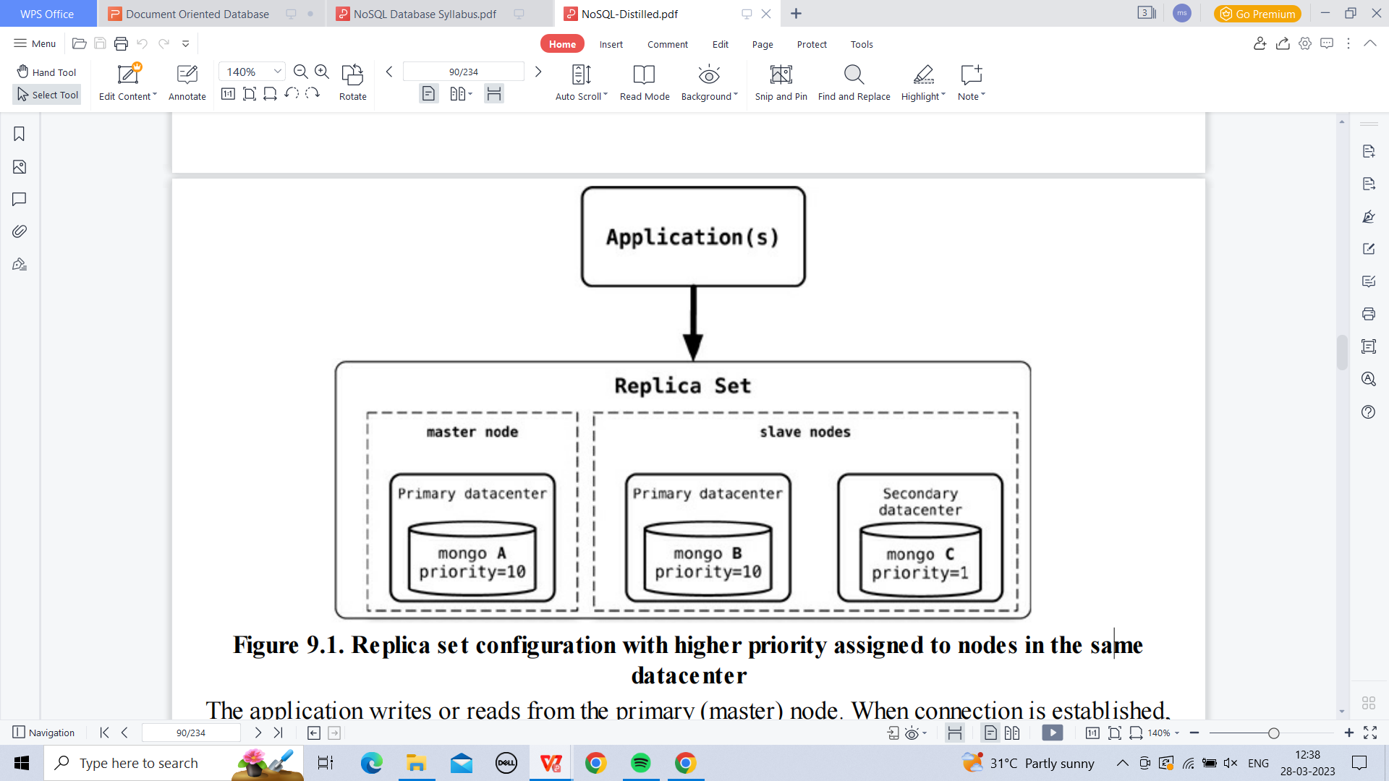
Document Database Features - Availability
The application does not have to manage any of the communication failures or node selection criteria. Using replica sets gives you the ability to have a highly available document data store. Replica sets are generally used for data redundancy, automated failover, read scaling, server maintenance without downtime, and disaster recovery. Similar availability setups can be achieved with CouchDB, RavenDB, Terrastore, and other products

Slide 20
Document Database Features - Query Features
Document databases provide different query features. CouchDB allows you to query via views— complex queries on documents which can be either materialized (“Materialized Views,” p. 30) or dynamic (think of them as RDBMS views which are either materialized or not). With CouchDB, if you need to aggregate the number of reviews for a product as well as the average rating, you could add a view implemented via map-reduce (“Basic Map-Reduce,” p. 68) to return the count of reviews and the average of their ratings.
When there are many requests, you don’t want to compute the count and average for every request; instead you can add a materialized view that precomputes the values and stores the results in the database. These materialized views are updated when queried, if any data was changed since the last update.
One of the good features of document databases, as compared to key-value stores, is that we can query the data inside the document without having to retrieve the whole document by its key and then introspect the document. This feature brings these databases closer to the RDBMS query model

Slide 21
Document Database Features - Query Features
MongoDB has a query language which is expressed via JSON and has constructs such as $query for the where clause, $orderby for sorting the data, or $explain to show the execution plan of the query. There are many more constructs like these that can be combined to create a MongoDB query.
Let’s look at certain queries that we can do against MongoDB. Suppose we want to return all the documents in an order collection (all rows in the order table).
SELECT * FROM order
The equivalent query in Mongo shell would be: db.order.find() Selecting the orders for a single customerId of 883c2c5b4e5b would be:
SELECT * FROM order WHERE customerId = "883c2c5b4e5b"
The equivalent query in Mongo to get all orders for a single customerId of 883c2c5b4e5b:
db.order.find({"customerId":"883c2c5b4e5b"})

Slide 22
Document Database Features - Query Features
Similarly, selecting orderId and orderDate for one customer in SQL would be:
SELECT orderId,orderDate FROM order WHERE customerId = "883c2c5b4e5b"
and the equivalent in Mongo would be: db.order.find({customerId:"883c2c5b4e5b"},{orderId:1,orderDate:1})
Similarly, queries to count, sum, and so on are all available. Since the documents are aggregated objects, it is really easy to query for documents that have to be matched using the fields with child objects. Let’s say we want to query for all the orders where one of the items ordered has a name like Refactoring.
SELECT * FROM customerOrder, orderItem, product WHERE customerOrder.orderId = orderItem.customerOrderId AND orderItem.productId = product.productId AND product.name LIKE '%Refactoring%'
and the equivalent Mongo query would be: db.orders.find({"items.product.name":/Refactoring/})
The query for MongoDB is simpler because the objects are embedded inside a single document and you can query based on the embedded child documents.

Slide 23
Document Database Features - Scaling
The idea of scaling is to add nodes or change data storage without simply migrating the database to a bigger box. We are not talking about making application changes to handle more load; instead, we are interested in what features are in the database so that it can handle more load.
Scaling for heavy-read loads can be achieved by adding more read slaves, so that all the reads can be directed to the slaves. Given a heavy-read application, with our 3-node replica-set cluster, we can add more read capacity to the cluster as the read load increases just by adding more slave nodes to the replica set to execute reads with the slaveOk flag . This is horizontal scaling for reads

Slide 24
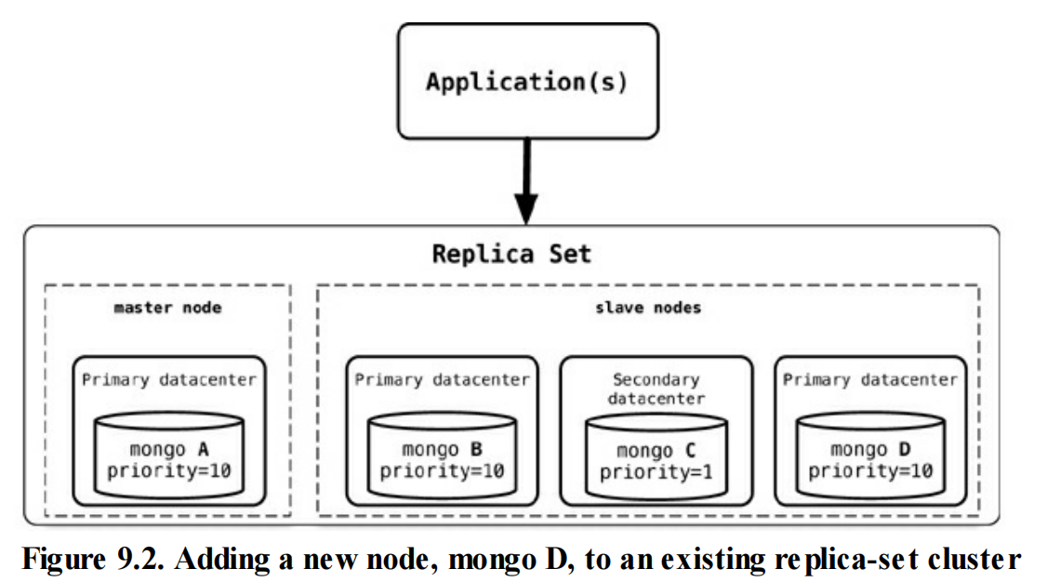
Document Database Features - Scaling
Once the new node, mongo D, is started, it needs to be added to the replica set. rs.add("mongod:27017");
When a new node is added, it will sync up with the existing nodes, join the replica set as secondary node, and start serving read requests. An advantage of this setup is that we do not have to restart any other nodes, and there is no downtime for the application either.

Slide 25
Document Database Features - Scaling
When we want to scale for write, we can start sharding the data. Sharding is similar to partitions in RDBMS where we split data by value in a certain column, such as state or year. With RDBMS, partitions are usually on the same node, so the client application does not have to query a specific partition but can keep querying the base table; the RDBMS takes care of finding the right partition for the query and returns the data.
In sharding, the data is also split by certain field, but then moved to different Mongo nodes. The data is dynamically moved between nodes to ensure that shards are always balanced. We can add more nodes to the cluster and increase the number of writable nodes, enabling horizontal scaling for writes.
db.runCommand( { shardcollection : "ecommerce.customer", key : {firstname : 1} } )
Splitting the data on the first name of the customer ensures that the data is balanced across the shards for optimal write performance; furthermore, each shard can be a replica set ensuring better read performance within the shard. When we add a new shard to this existing sharded cluster, the data will now be balanced across four shards instead of three. As all this data movement and infrastructure refactoring is happening, the application will not experience any downtime, although the cluster may not perform optimally when large amounts of data are being moved to rebalance the shards.

Slide 26
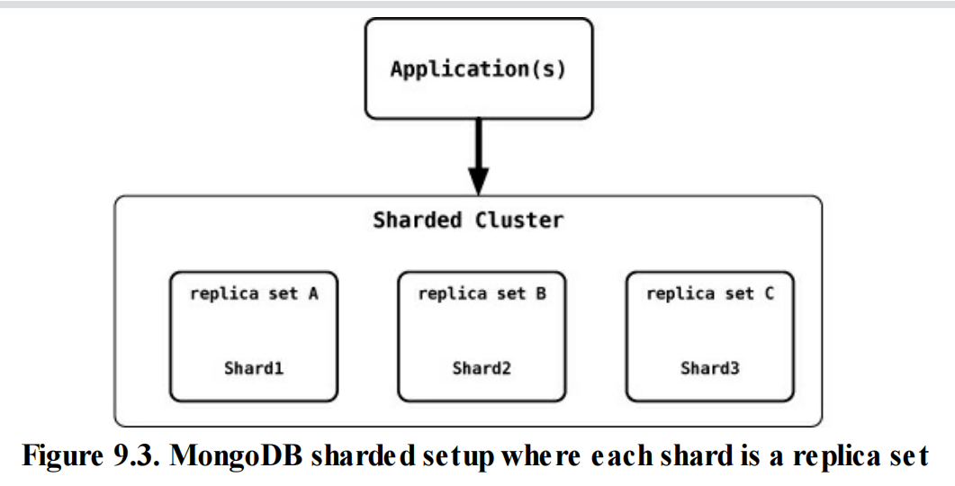
Document Database Features - Scaling
The shard key plays an important role. You may want to place your MongoDB database shards closer to their users, so sharding based on user location may be a good idea. When sharding by customer location, all user data for the East Coast of the USA is in the shards that are served from the East Coast, and all user data for the West Coast is in the shards that are on the West Coast.

Slide 27
Advantages of Document Databases
Flexible schema: Document databases allow for a flexible, schema-less data model, which can make it easier to adapt to changing requirements and handle unstructured or semi-structured data.
High performance: Document databases are designed for fast read and write performance, which can be especially important in high-traffic web and mobile applications.
Scalability: Document databases are often horizontally scalable, which means that they can handle a large amount of data and a high number of concurrent users.
Ease of use: Many document databases have a simple and intuitive API, which can make them easy to use and integrate into existing applications.
Nested data structures: Document databases can store nested data structures, which can make it easier to store and query complex data

Slide 28
Disadvantages of Document Databases
Limited querying capabilities: Compared to relational databases, document databases may have limited querying capabilities, particularly when it comes to performing complex, multi-table joins.
Data consistency: In a schema-less model, it may be more difficult to enforce data consistency and integrity.
Limited ACID support: Some document databases may have limited support for ACID (Atomicity, Consistency, Isolation, Durability) transactions, which can make it difficult to ensure data consistency in certain situations.
Data validation: Some document databases may not have built-in support for data validation, which can make it difficult to ensure data consistency and integrity.
Backup and Recovery: Backup and Recovery process may be more complex than traditional relational databases.

Slide 29
When to Use Document Database
When you have semi-structured or unstructured data: Document databases are well suited for storing data that does not have a fixed schema, such as JSON or XML documents.
When you need to store hierarchical or nested data: Document databases can store nested data structures, which can make it easier to store and query complex data.
When you need a high level of scalability: Document databases are often horizontally scalable, which means that they can handle a large amount of data and a high number of concurrent users.
When you need fast read and write performance: Document databases are designed for fast read and write performance, which can be especially important in high-traffic web and mobile applications.our application..

Slide 30
When to Use Document Database
When you need a flexible data model: Document databases allow you to store data in a flexible, schema-less format, which can make it easier to adapt to changing requirements.
When you are working with polyglot persistence: Document databases can work well alongside other types of databases, such as key-value or graph databases, to support different use cases and workloads in your application..

Slide 31
When Not to Use Document Database
There are problem spaces where document databases are not the best solution.
Complex Transactions Spanning Different Operations:If you need to have atomic cross-document operations, then document databases may not be for you. However, there are some document databases that do support these kinds of operations, such as RavenDB.
Queries against Varying Aggregate Structure: Flexible schema means that the database does not enforce any restrictions on the schema. Data is saved in the form of application entities. If you need to query these entities ad hoc, your queries will be changing (in RDBMS terms, this would mean that as you join criteria between tables, the tables to join keep changing). Since the data is saved as an aggregate, if the design of the aggregate is constantly changing, you need to save the aggregates at the lowest level of granularity—basically, you need to normalize the data. In this scenario, document databases may not work.

